Slide 1



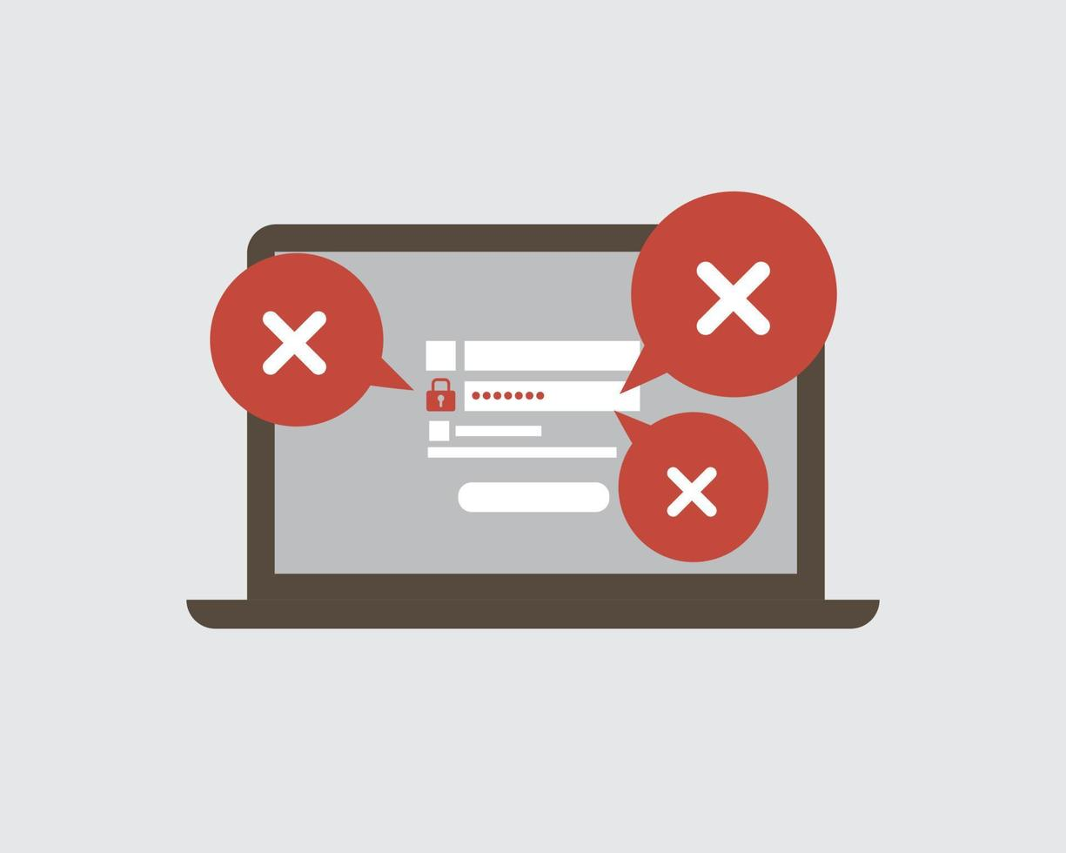





Student:
___ _
Let's play hackers!
How to create a secure password?

Slide 2
Password comparison
When we have to create passwords, we find different instructions depending on the application or website.
MOBILE PUK 8 numbers
GMAIL : 8 elements minimum with uppercase, lowercase letters, numbers and special characters (as desired)
TEACHER EMAIL : 8 elements minimum, alphanumeric, at least one uppercase letter, one lowercase letter and one number
INSTITUTE MAIL : 8 elements minimum, alphanumeric, at least one capital letter or a special character
BANK PIN : 8 lowercase letters
CHILDREN'S MAIL : 8 elements, 4 capital letters followed by 4 numbers
Which ones do you think are safer? Why?

Slide 3
Password comparison
Workspace (notes, calculations, diagrams,...)

Slide 4
Password comparison
Sort passwords from least to most secure.
Justify your answers.

Slide 5
Creating passwords
Make a proposal for creating a password for the institute's email and justify why it is secure enough.

Slide 6
'
Evaluation rubric
Aspect to review | What have I done?
1. Data analysis and interpretation | I consider specific examples of passwords of each type. I use lists, tables or diagrams to organize the data and make sure I am counting all the cases.
2. Computational thinking | I associate each password with: a type of padlock, a general calculation or a formula. I consider some specific steps to organize the calculations. I calculate the total number of passwords of each type.
3. Argumentation and verification | I explain why one password is more secure than another, using general arguments or calculations. I review the results to make sure there are no errors. I am looking for other ways to solve the problem to confirm the answer.
4. Mathematical communication | I clearly explain the steps I follow. I use appropriate mathematical language. I use diagrams, tables or charts to better explain the process. I check if my explanations are consistent with the calculations I have made.

